Slide 1
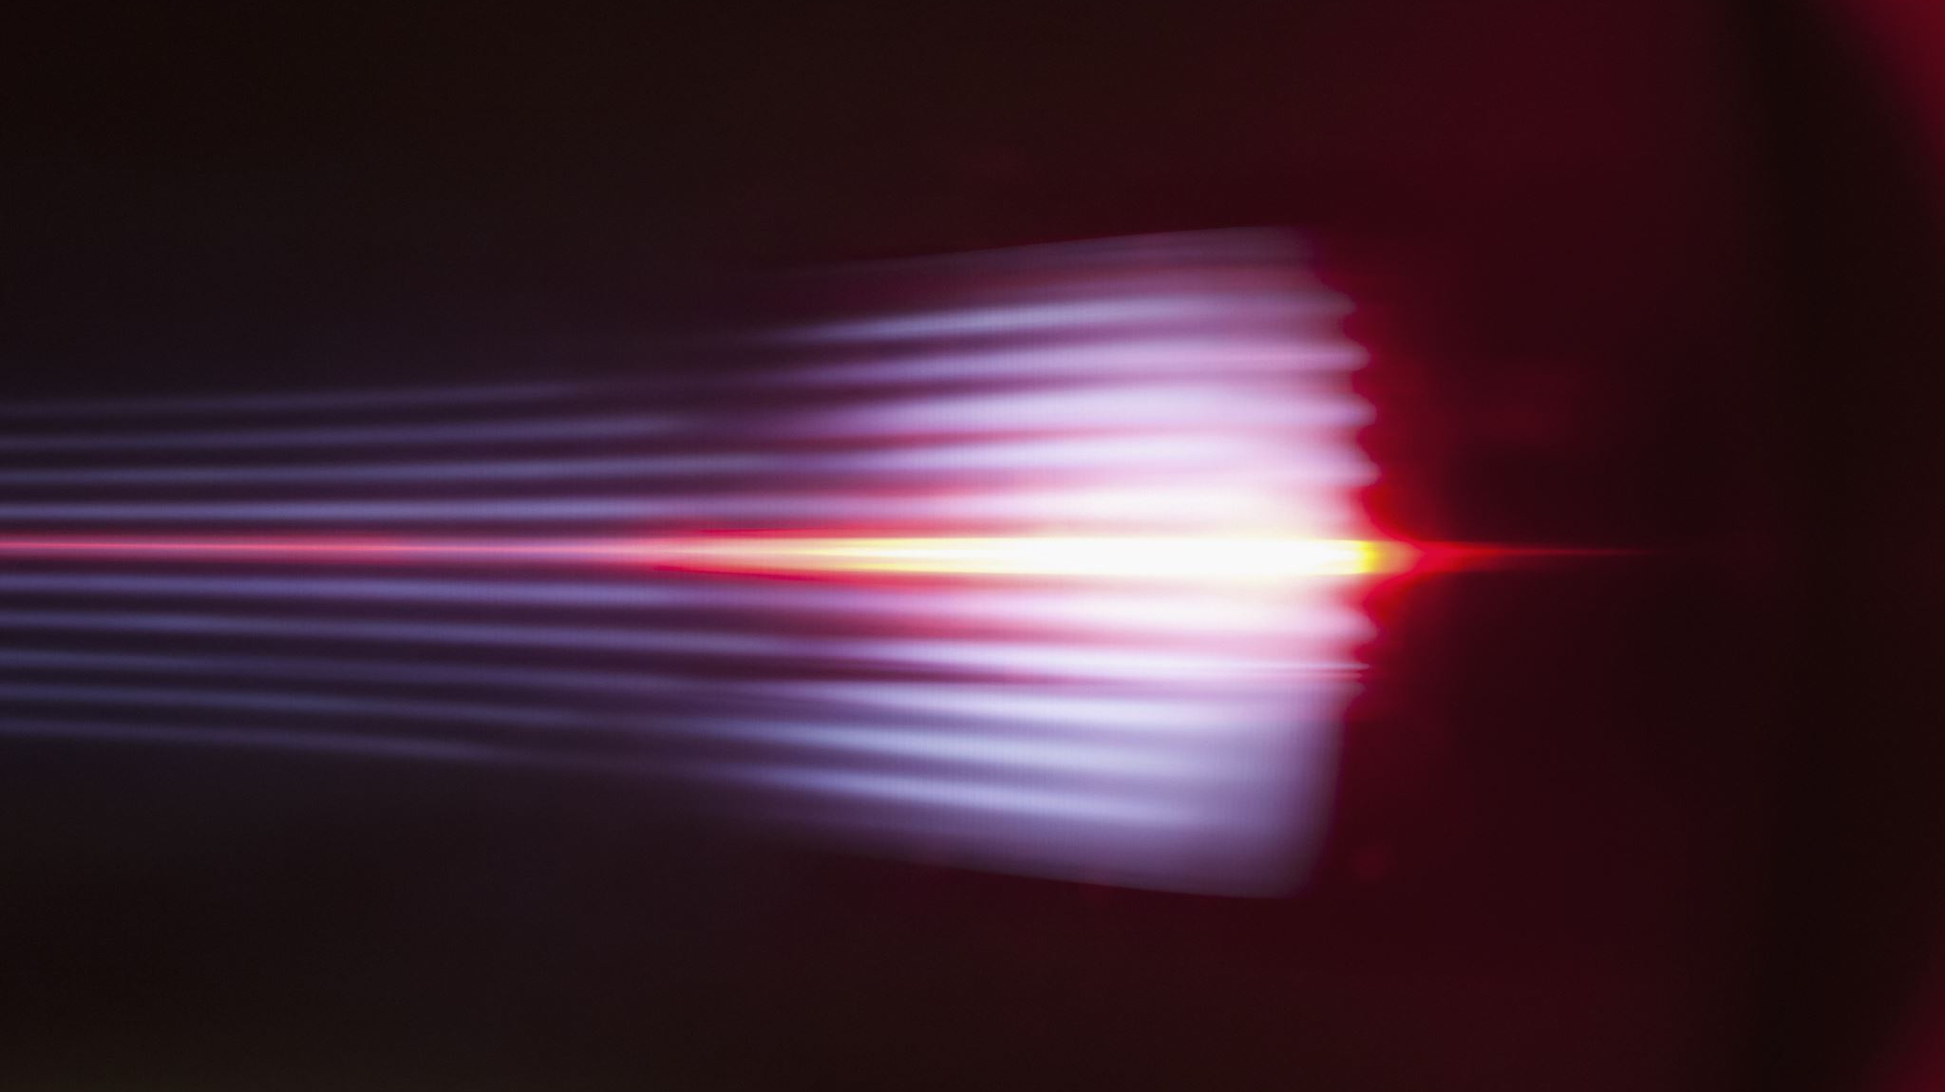
Object contours detection in motion-blurred image
Presented by:
Angela Remolina and Semjon Tukmatsov
IACV project 2023-2024

Slide 2

Agenda
Problem formulation
Definitions + State of the art
Proposed approach
Implementation
Experiments
Conclusions + Future work

Slide 3

Problem formulation

Slide 4

Definitions
Motion-blurred images
Threshold
Trimap
Sobel operator
Alpha-matting
Gradiant

Slide 5


Past studies
A closed form solution to natural image matting (A. Levin, D. Lischinski, Y. Weiss)
On the Apparent Transparency of a Motion Blurred Object (V. Caglioti, A. Giusti.)
Pymatting: A python library for alpha matting. (Germer, T. Uelwer, S. Conrad, and S. Harmeling)

Slide 6

Proposed approach
2 algorithms
One for alpha extraction
Another one for contour detection

Slide 7
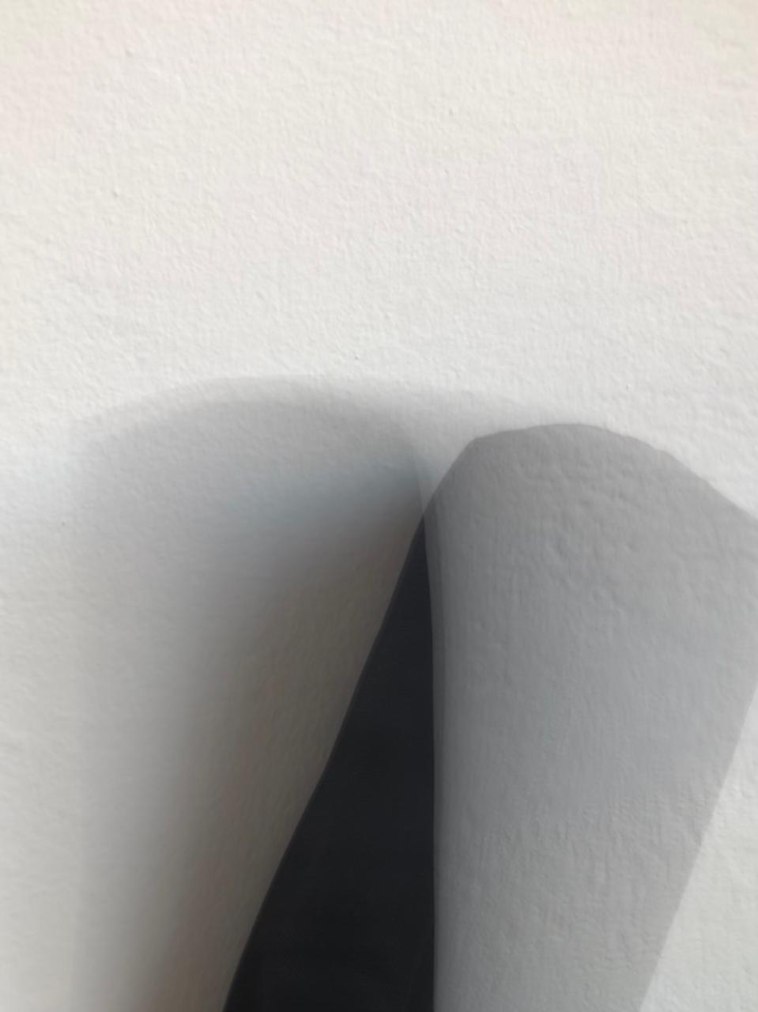


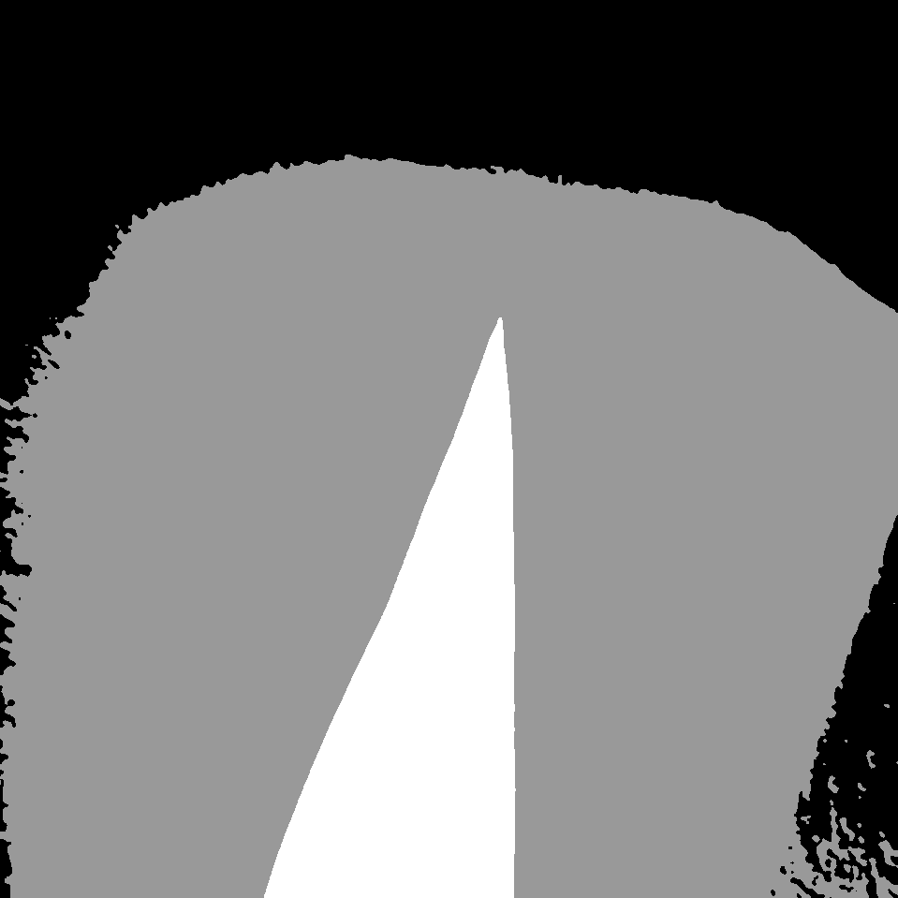
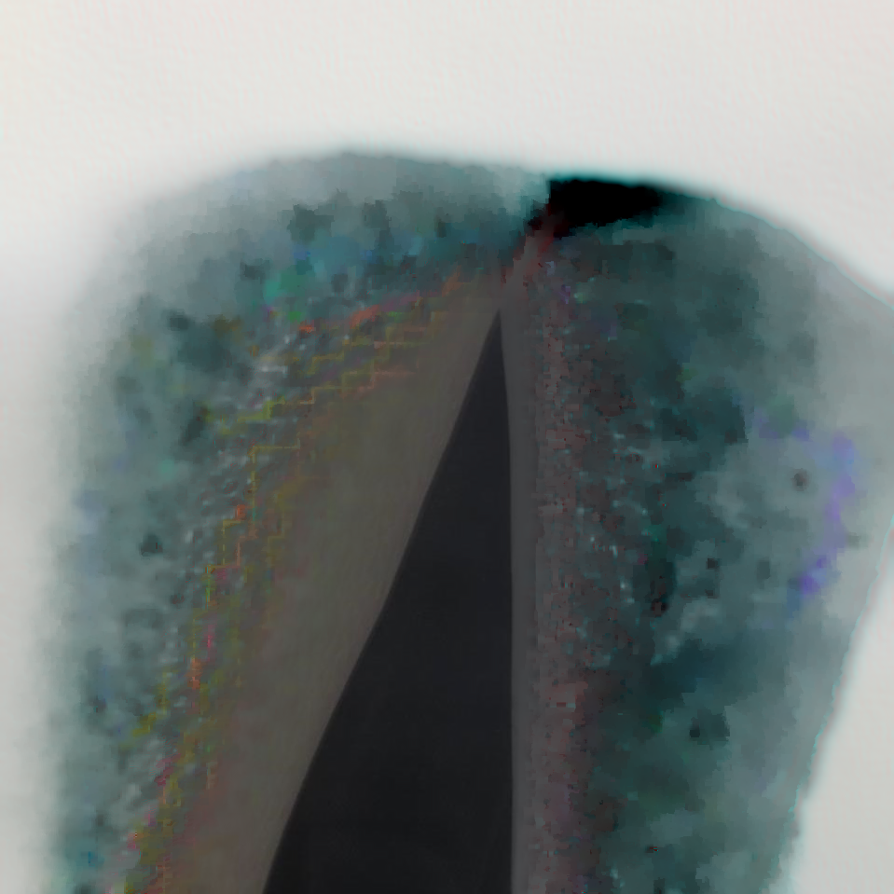
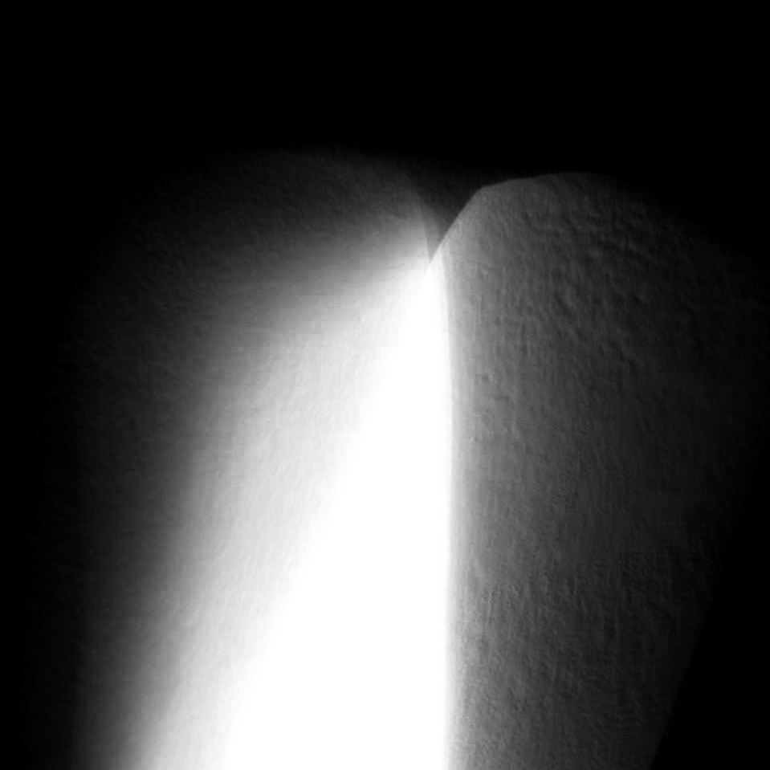
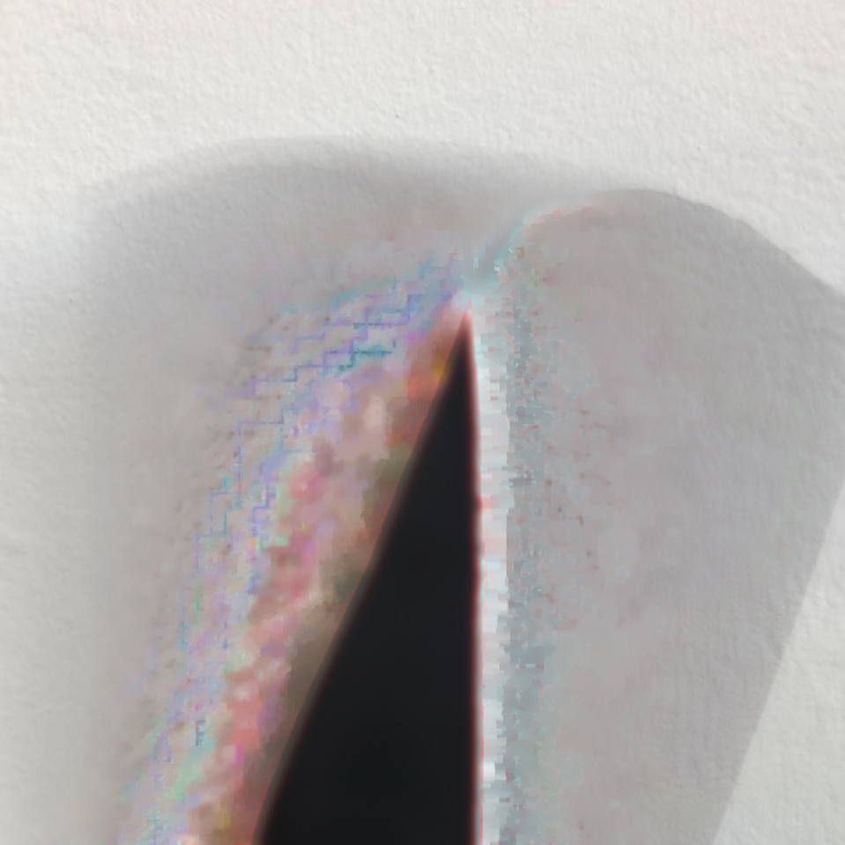
Alpha matte estimation algorithm
Pre-processing the image
1. Convert the image to grayscale
Create a 2 masks of the image (broad and strict)
Using a custom threshold that separates by color intensity
Calculate the trimap
Using the intersection of the 2 masks found before
2. Reduce noise in image
Using Closed Form proposed in past studies
Extract the alpha matte, foreground and background

Slide 8
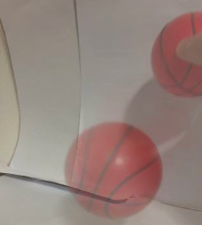
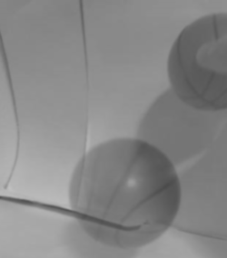
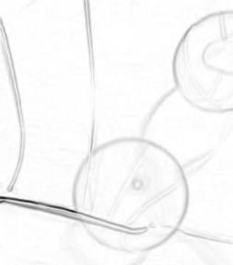
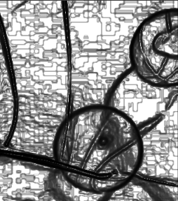
Object contour gradient algorithm
Pre-processing the image
1. Convert the image to grayscale
Calculate Gradient
2. Reduce noise in image
Extract object contours with outlined borders
Equalizing the histogram of the image
Using the Sobel operator on axis X and Y

Slide 9



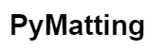
Implementation

Slide 10

Experiments

Slide 11
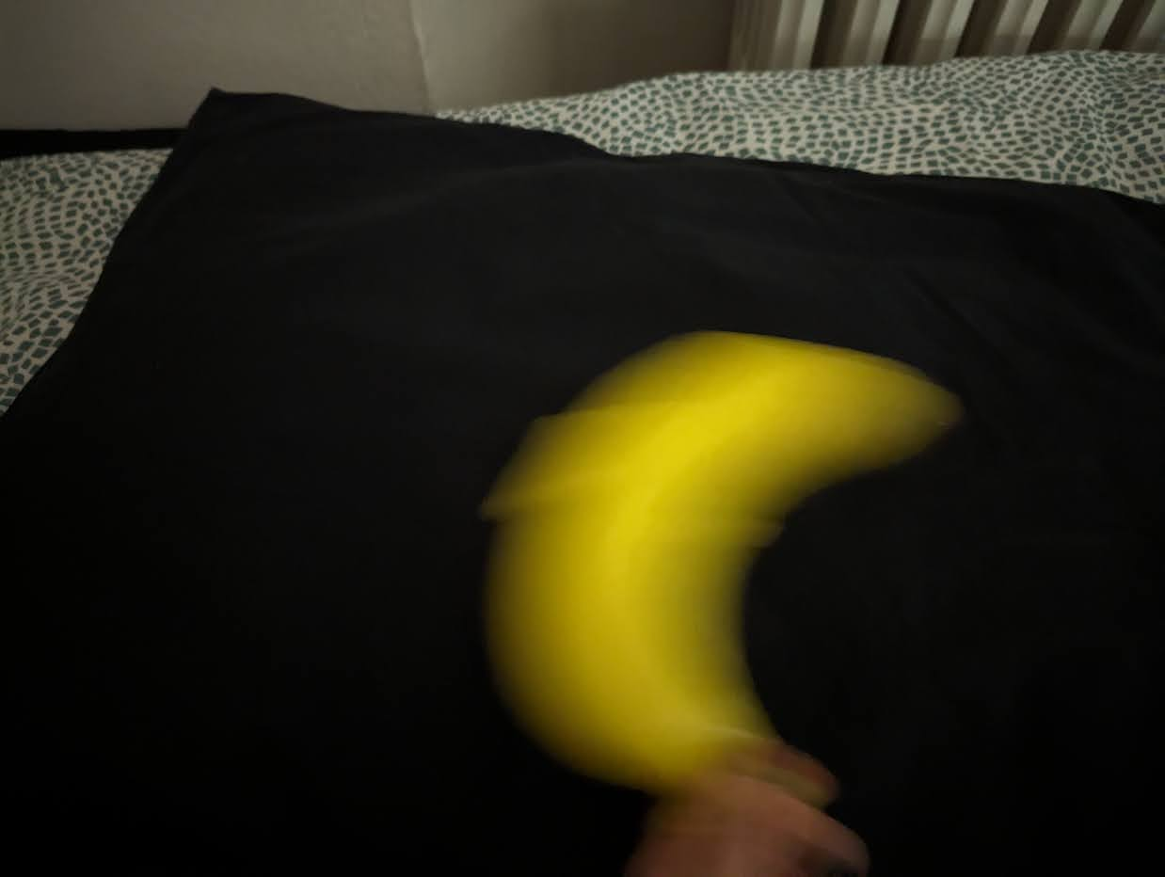
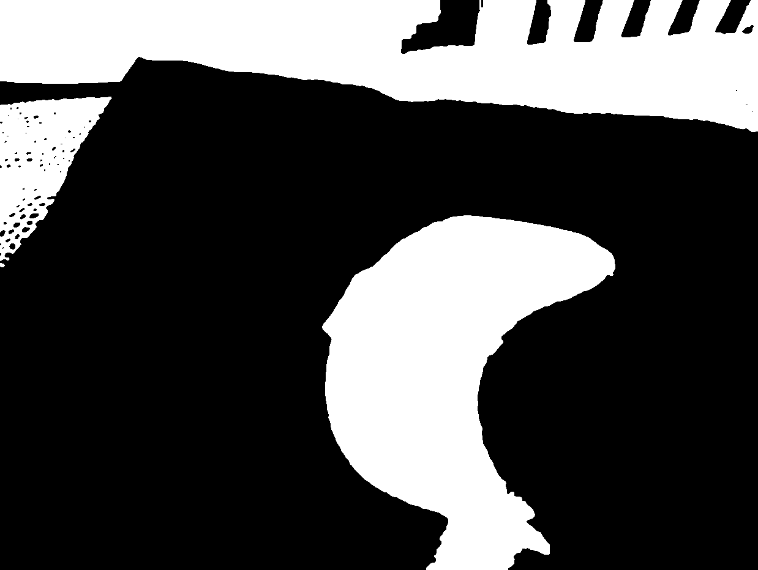
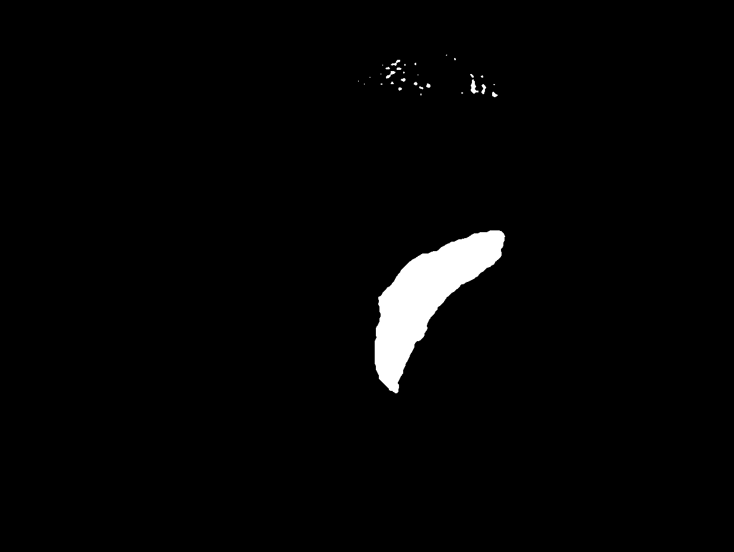
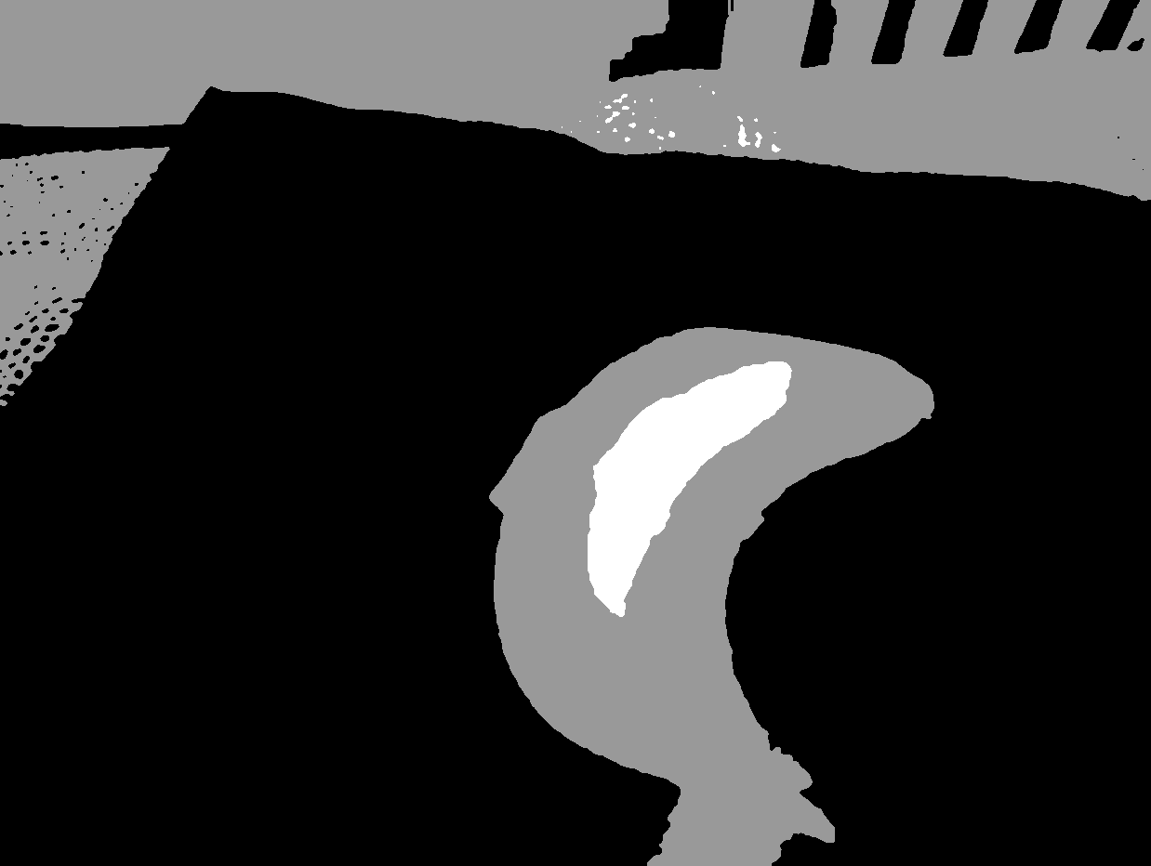
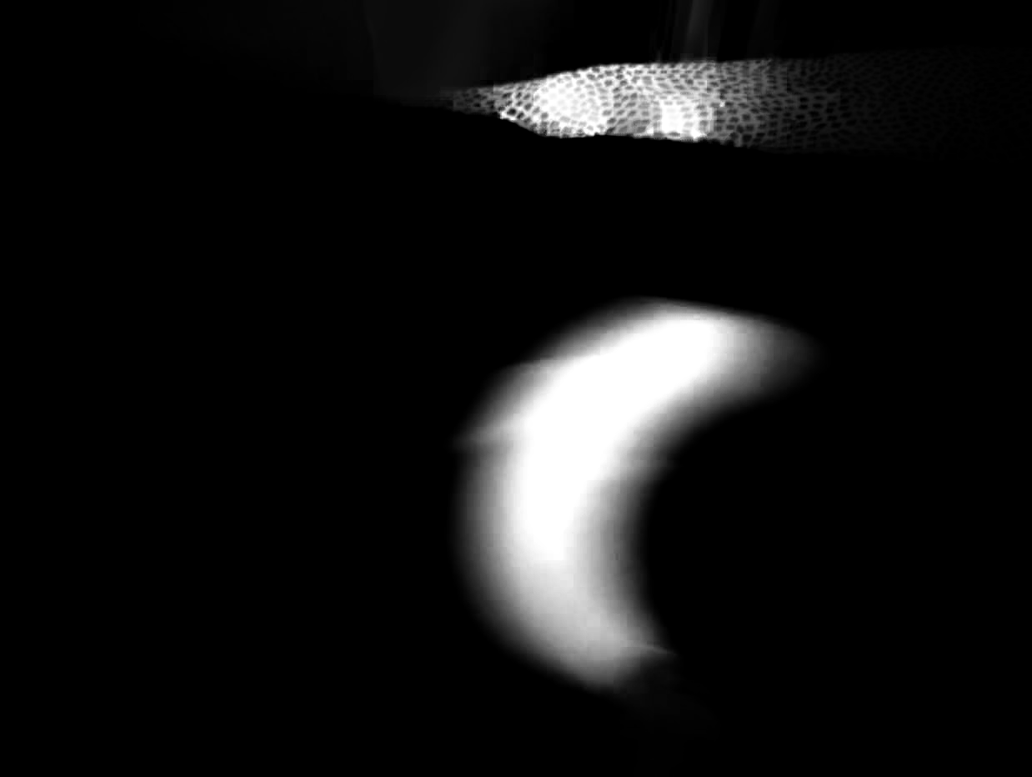
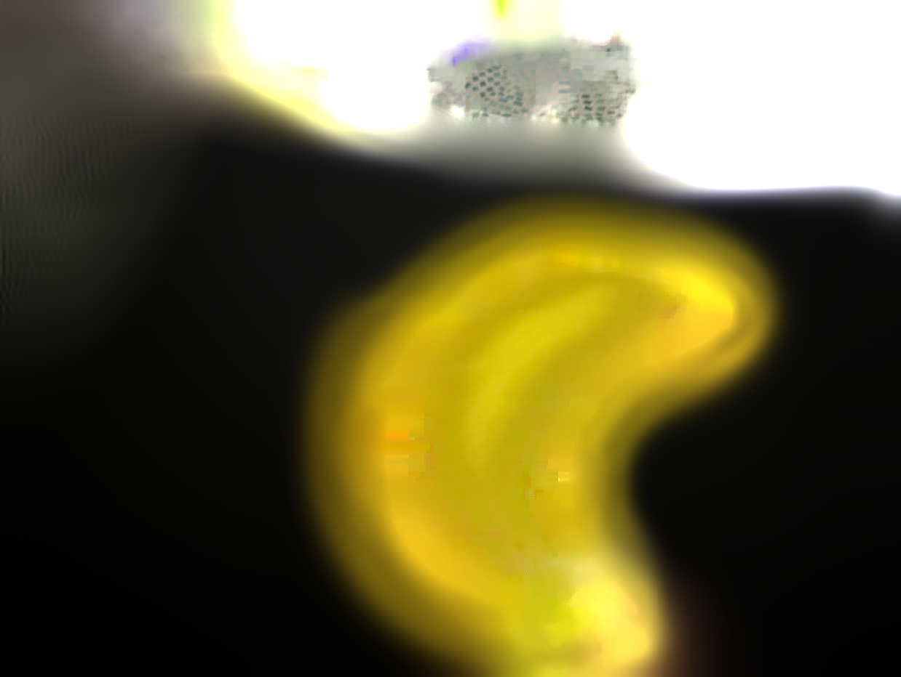
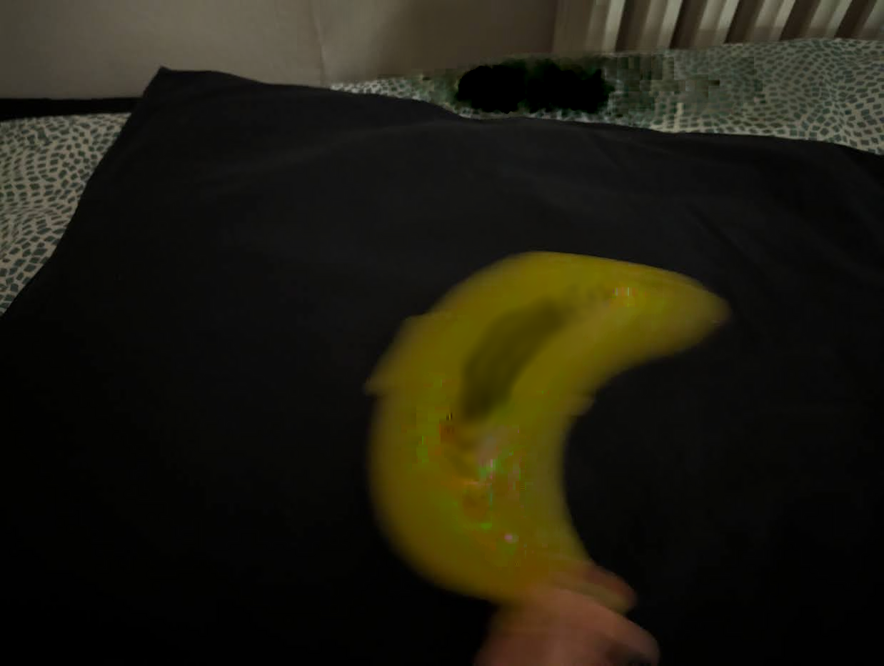
Alpha-matting

Slide 12
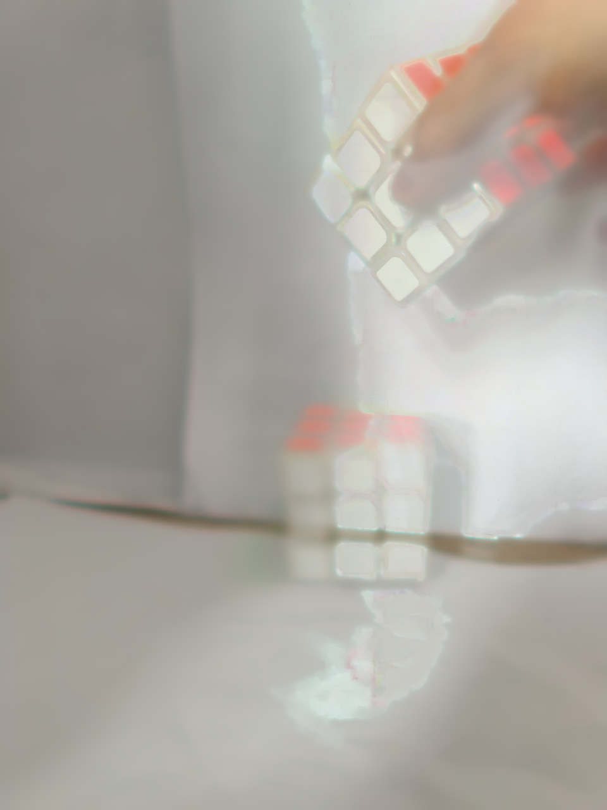
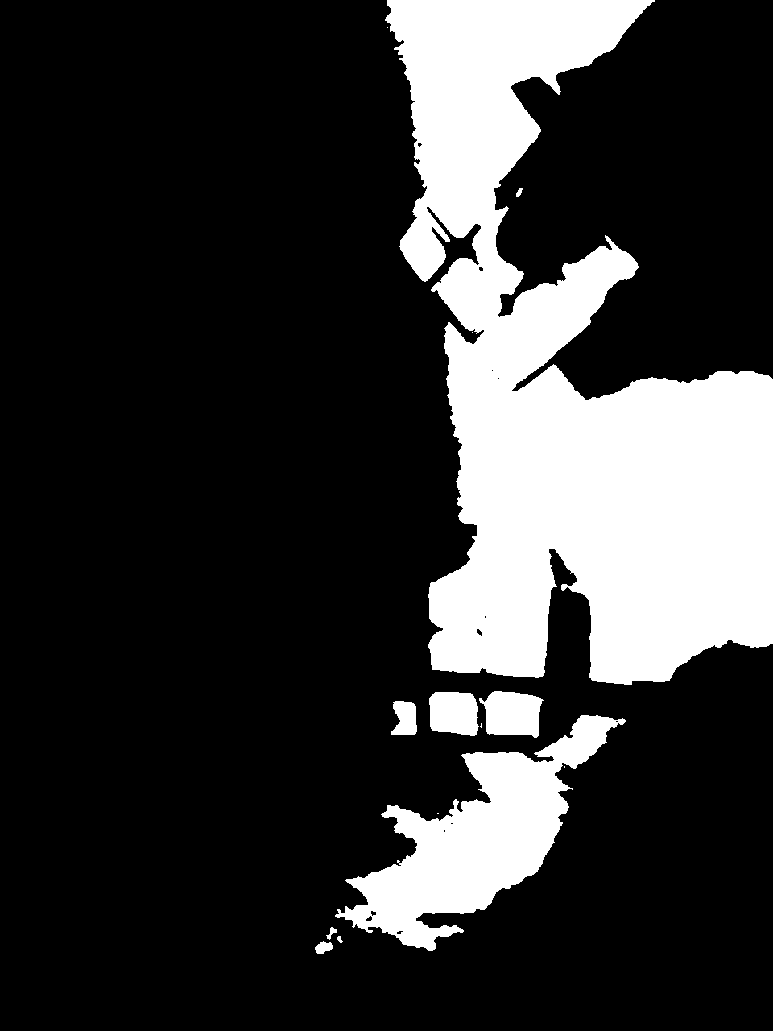
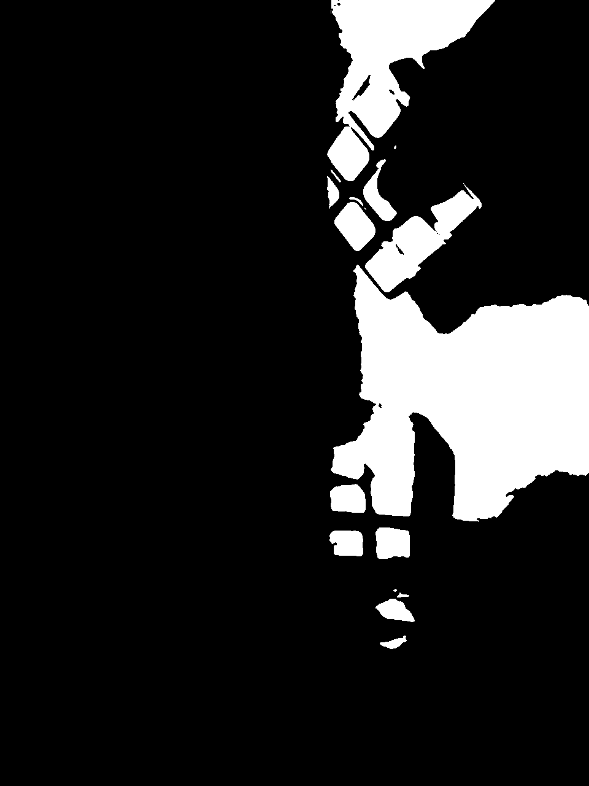
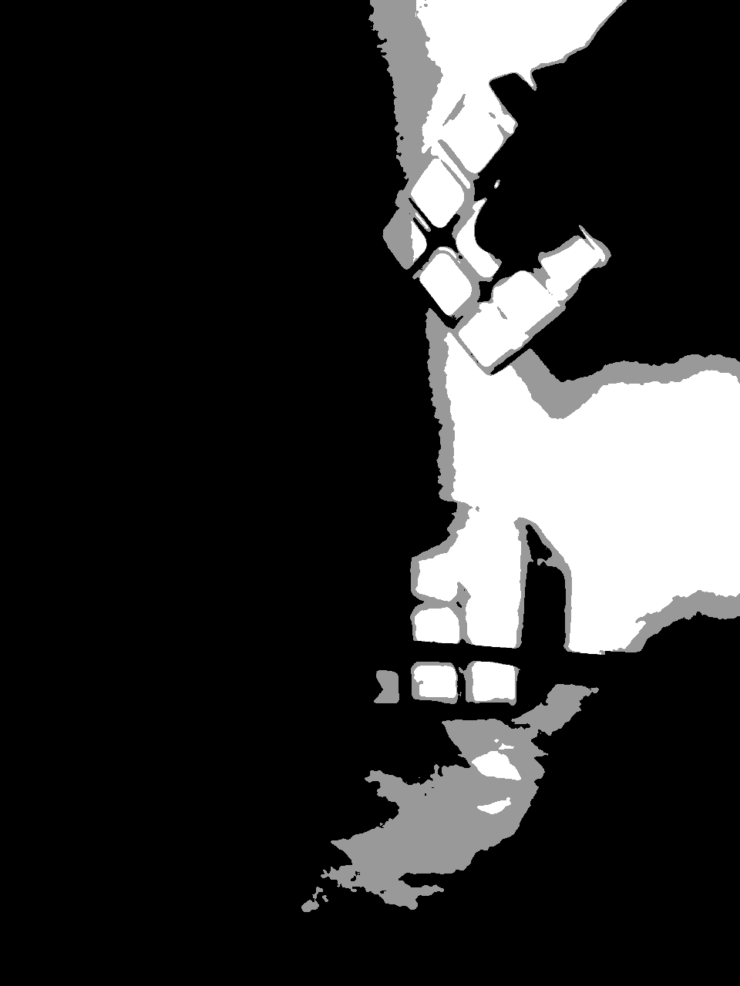
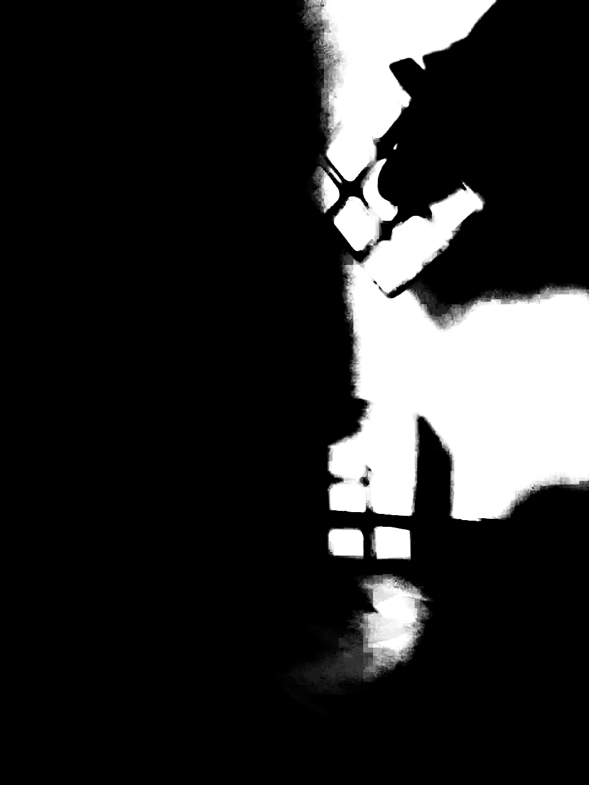
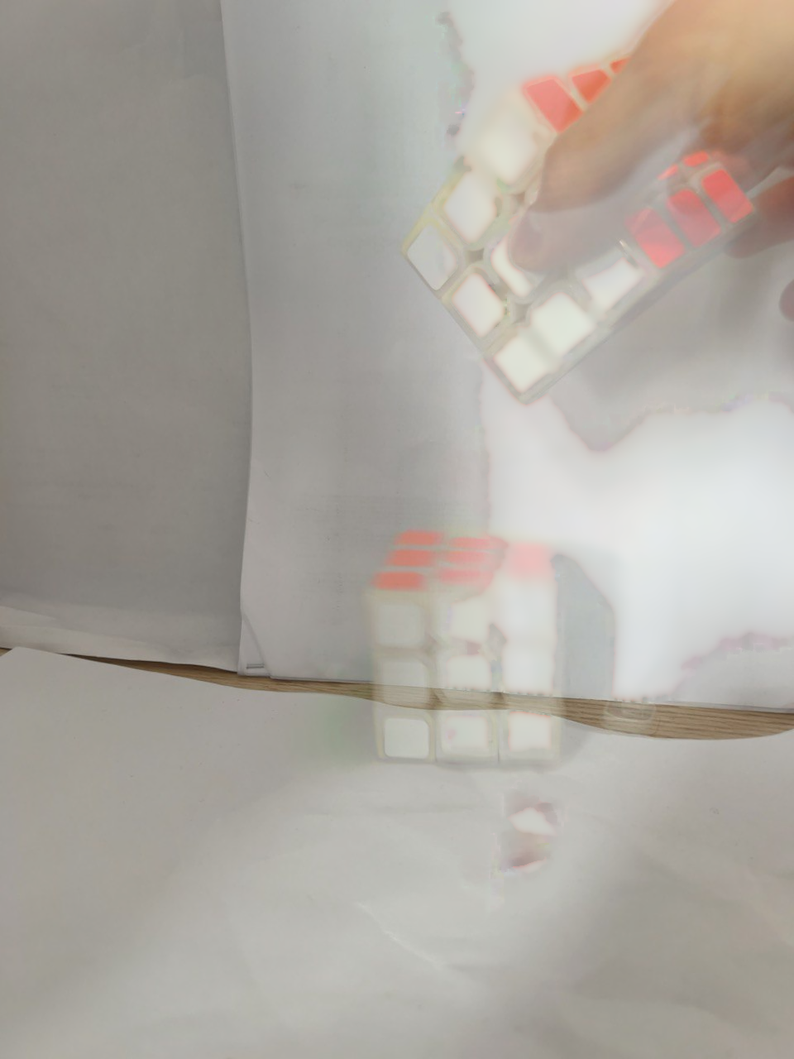
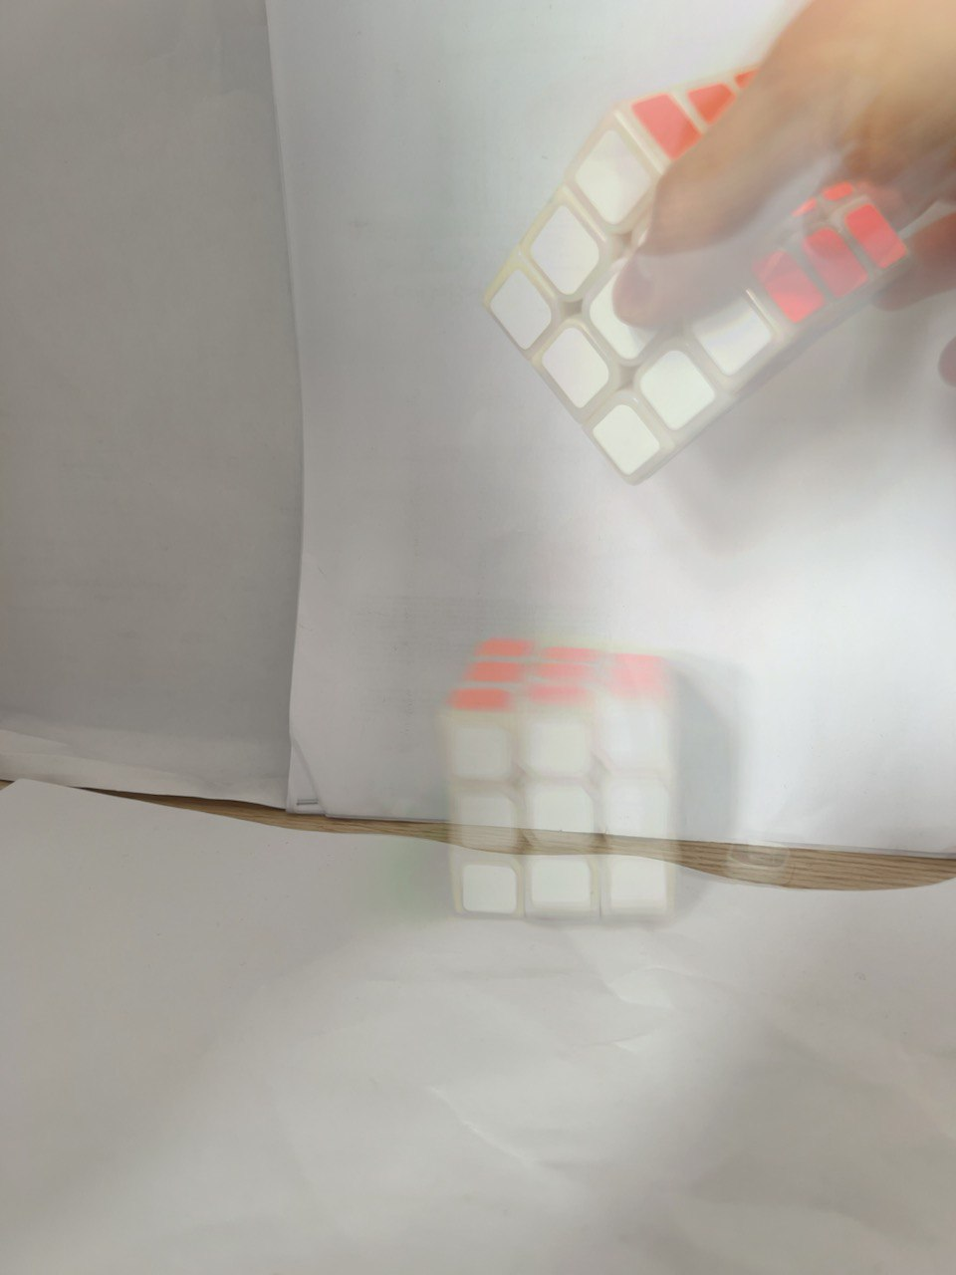

Slide 13
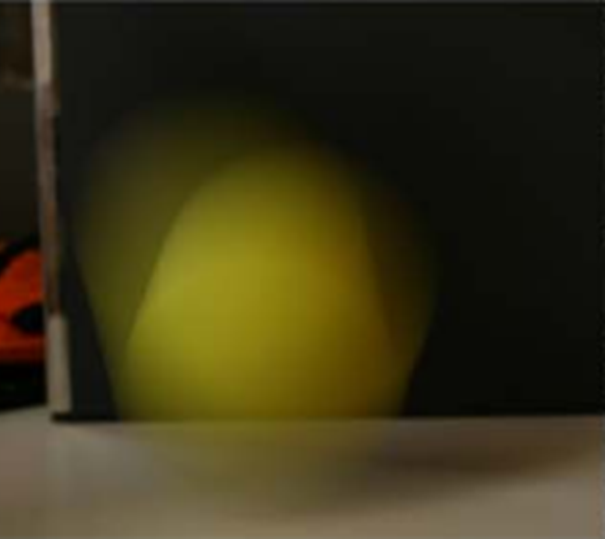
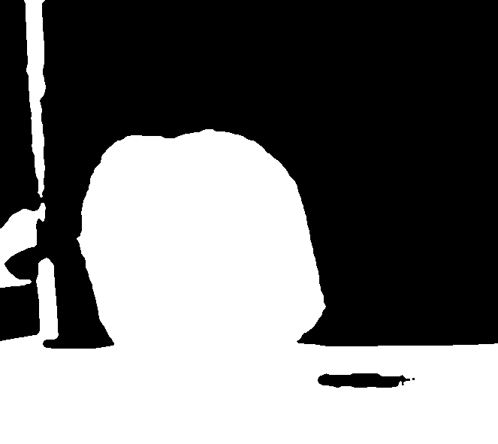
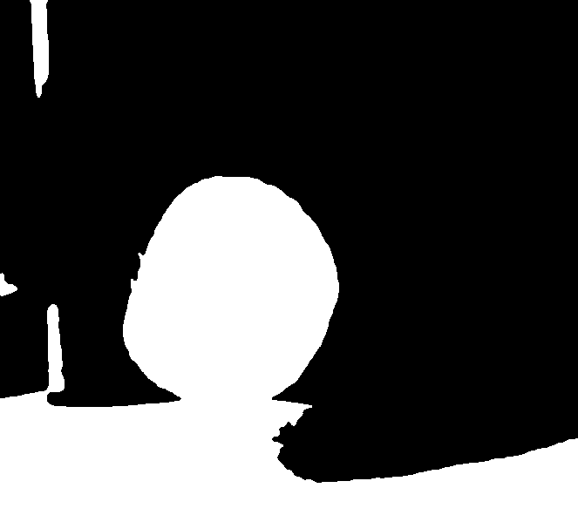
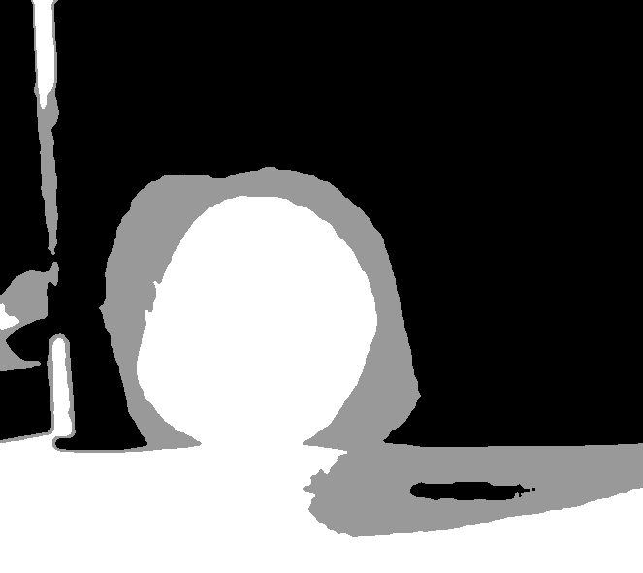
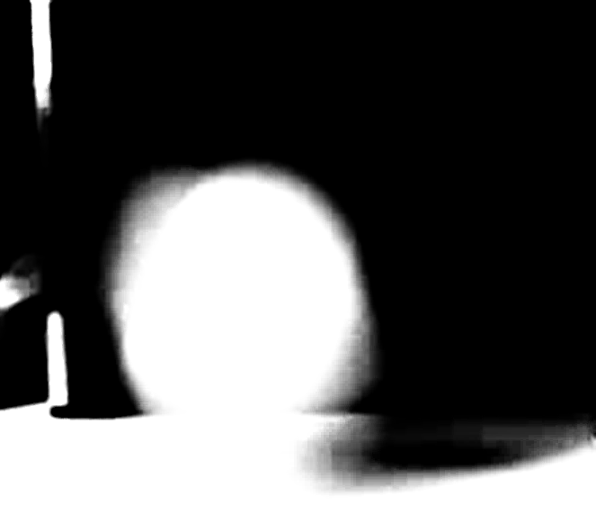
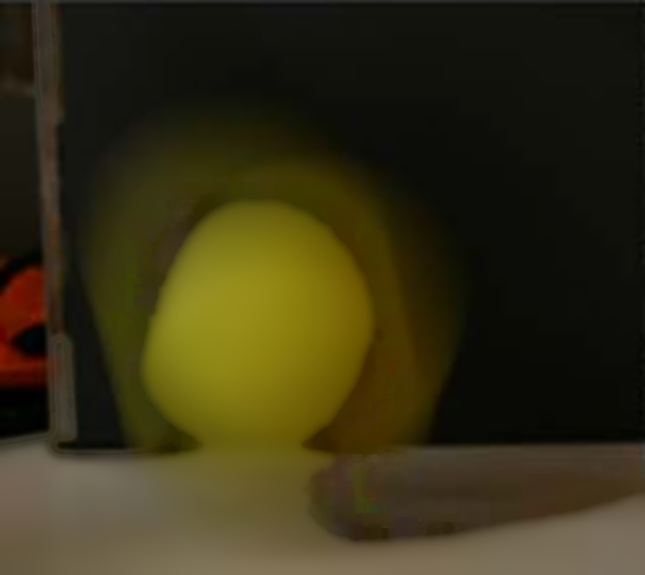
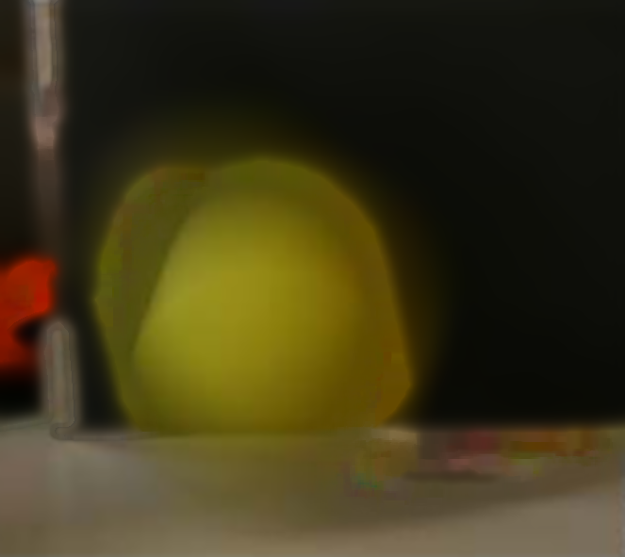

Slide 14
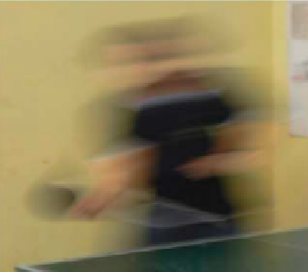
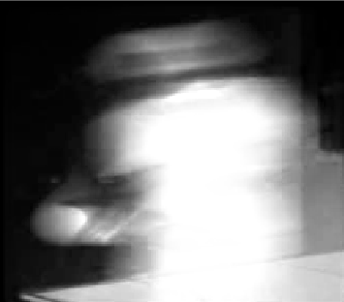
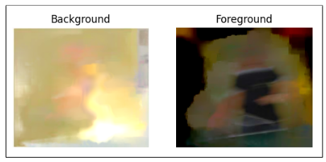

Slide 15
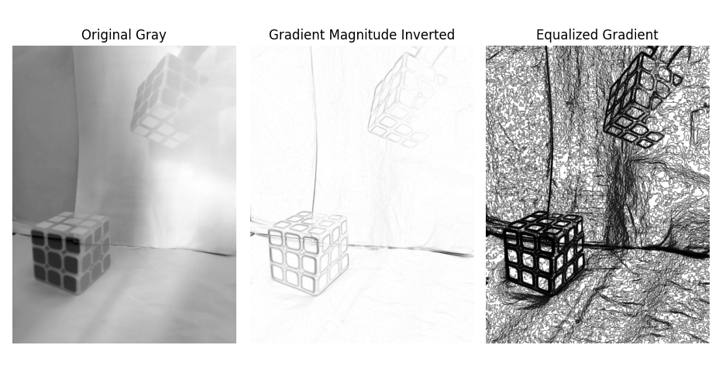
Gradient-outline

Slide 16
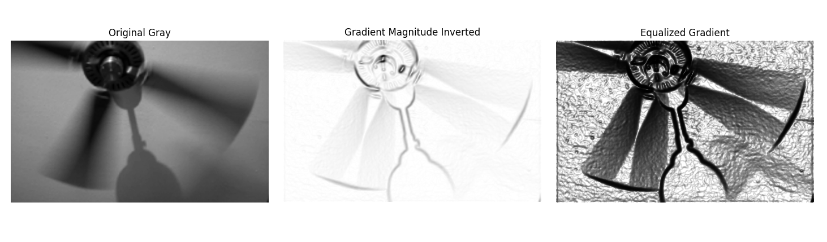

Slide 17
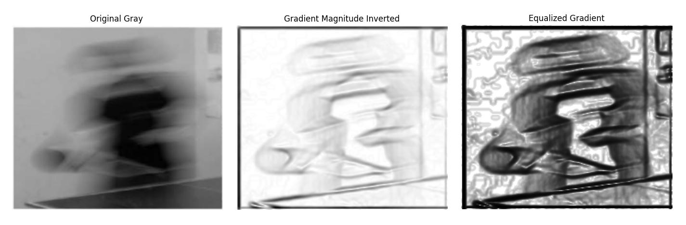

Slide 18

Conclusions and future work
The first algorithm focuses on alpha estimation using the Closed Form method, eliminating the need for user scribbles and improving accuracy.
The second algorithm concentrates on extracting well-defined object contours through techniques such as the Sobel operator and histogram equalization.
There is much left to investigate, including dynamic scenes with moving objects, varying speeds, non-rigid objects, and low-light conditions.

